Slide 1

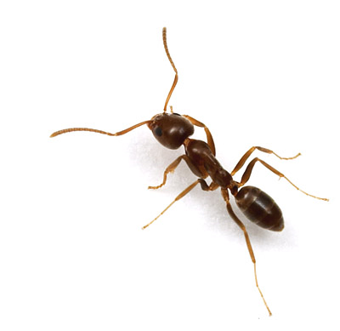
Modeling Ant Colony Behavior Using Agent Based Modeling
Department of Applied Mathematics University of Colorado-Boulder
Presenters: Justin Baacke, Max Bohning , J. Patrick O’Brien
Other active members: Adam Norris, David Kozak, Andrew Erickson, Donna Kuntzler, Carly Smith, , John Varkovitzky, Albert Como, Carrie Weidner, Connor Janowiak, Eric Benzel, Erik Bergal
Notes:
During this slide the history of our group should be given talk to Professor Norris about this.

Slide 2
Thank You!!
We would first like to thank the department of applied mathematics and the MTCP program for their support and encouragement.

Slide 3
Research on Ant Behavior
Deborah Gordon is a researcher at Stanford University who has spent over 20 years following a species of ants in New Mexico called the Red Harvester ants.
This research has generated a very strong basis for creating the base behaviors in an agent based model.

Slide 4
How to think about an ant colony
As a species it is more suitable to think of an ant colony as the organism rather than the regular ants as their evolutionary cycle revolves around a colony rather than the individual ants.
A queen mates once in her life and then lives deep in the colony for around 20 years
The individual worker ants are sterile females who live for roughly one year.
The colony only lasts as long as the queen.

Slide 5
How ants organize themselves
There is no central control whatsoever of the colony
The queen has no influence on the decisions of the colony.
There is an interaction based control system for the colony.
Each ant makes decisions off of the local information available to it and proceeds along with the appropriate behaviors.
This leads to a global function of the colony which is highly responsive to change in its surroundings and adaptive to new situations.

Slide 6
About Agent Based Modeling
Agent based modeling uses a large number of computer generated entities programed with situational specific behaviors interacting with each other to computationally model a dynamic system which may not be modeled using “traditional” techniques.

Slide 7
The Termite Problem
Stuff and termites are randomly generated on the field
Each termite has three behaviors:
Wander around randomly
If you land on a patch with stuff and your hands are empty, pick up the stuff
If you land on a patch with stuff and your hands are full, drop the stuff
A behavior for the system develops
This should be a video of the termite program.

Slide 8
Fireflys

Slide 9
Our Approach
Our Group in Boulder uses a program called Netlogo in which we program the base behaviors and run models of a day in the life of an ant colony finding these behaviors is the challenge.
We use the research from The Gordon Labs to find behaviors to program in and then fine tune them based off of the quantitative data provided.

